Slide 1
CUSTOMER RETENTION
E-retail factors for customer activation and retention: A case study from Indian e-commerce customers

Slide 2
Female – 175
Male - 90

Slide 3
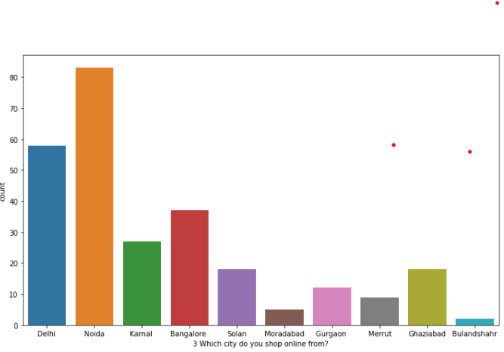

Slide 4
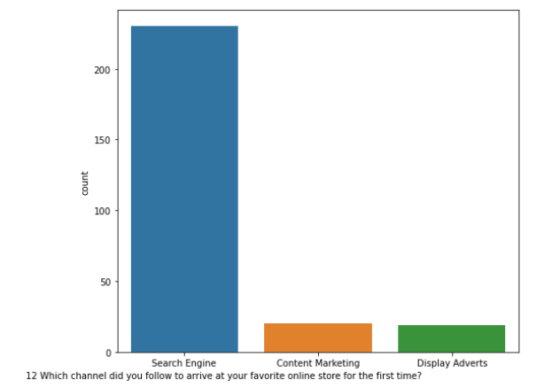

Slide 5
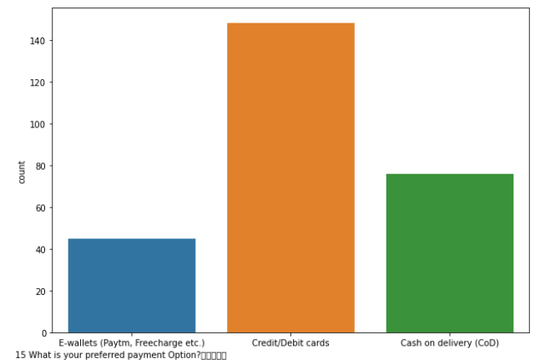

Slide 6
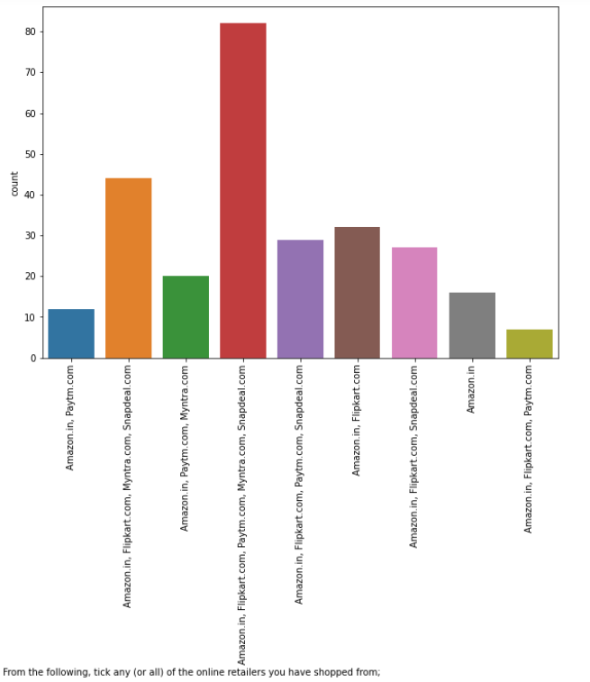

Slide 7
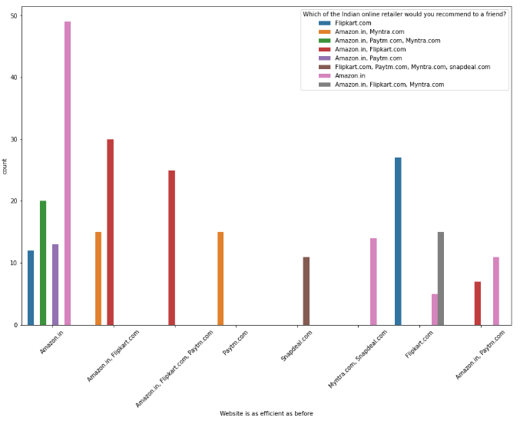

Slide 8
CONCLUSION

Slide 9
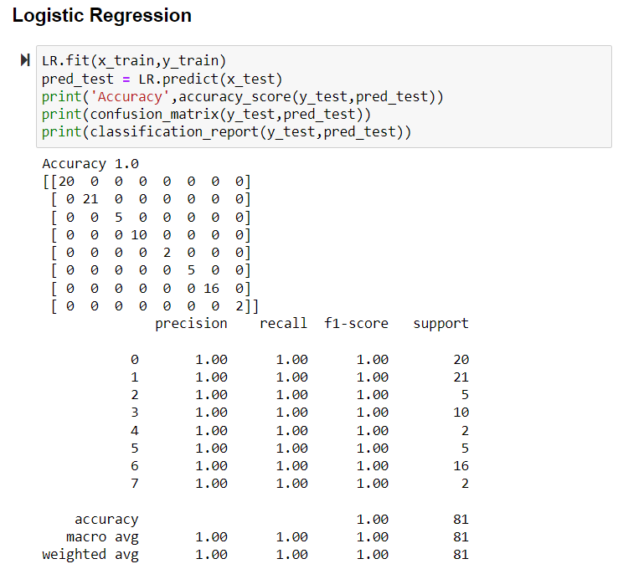

Slide 10
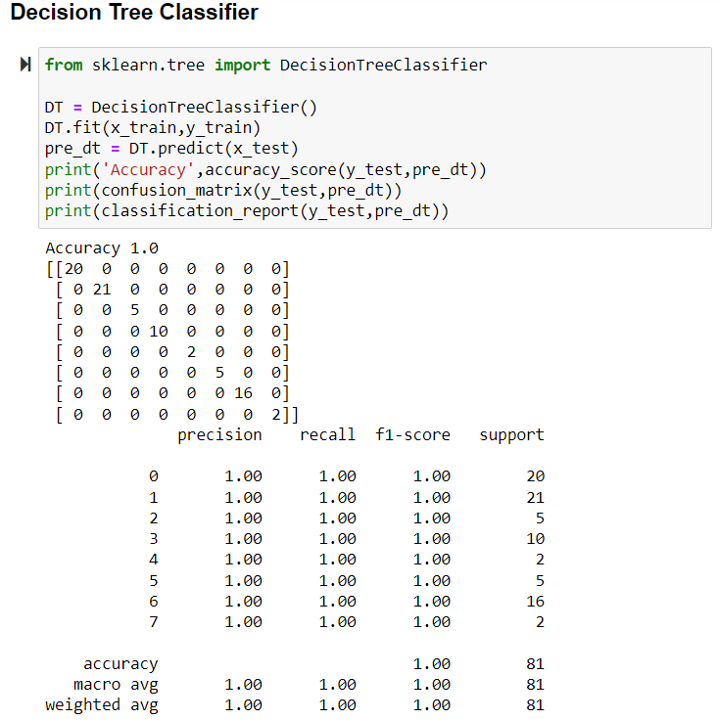

Slide 11
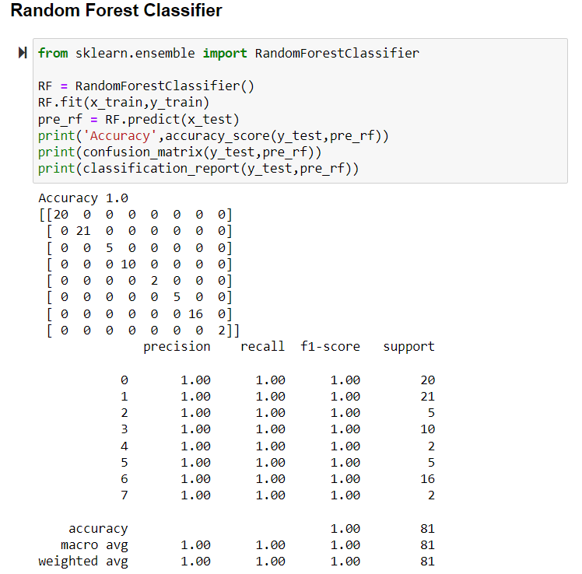

Slide 12
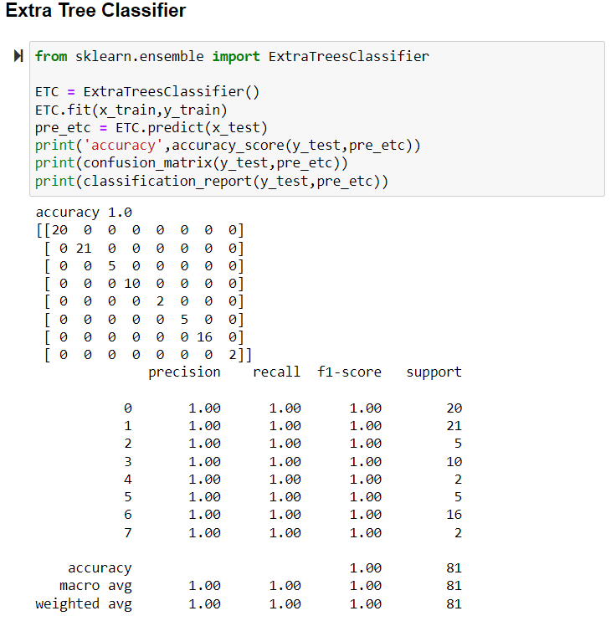

Slide 13
Accuray Score of all model is 100 percent.

